Slide 1

BIG DATA PROJECT
HOANG THANG MAI (610089) – THUONG HAN TRUONG (610088)

Slide 2
AGENDA
1. Java code InMapperWordCount
2. Java code Average
3. Output
4. Java code InMapperAverage
5. Output
6. Pseudo code for PAIR approach
7. Java code for PAIR approach
8. Result of PAIR approach
9. Pseudo code for STRIPE approach
10. Java code for STRIPE approach
11. Result of STRIPE approach
12. Pseudo code for HYBRID approach
13. Java code for HYBRID approach
14. Result of HYBRID approach
15. Time and resource comparison : Pair-Stripe-Hybrid
16. Spark Project Problem statement
17. Scala Code
18. Spark Project Output
DEPT. 4

Slide 3
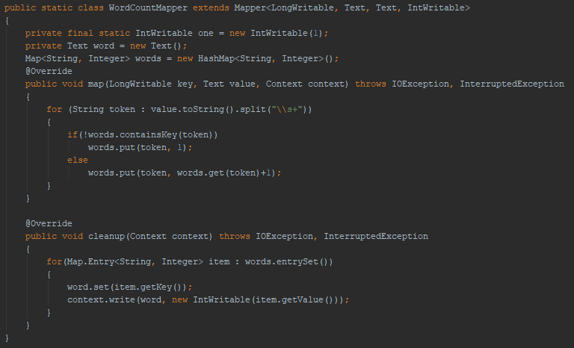
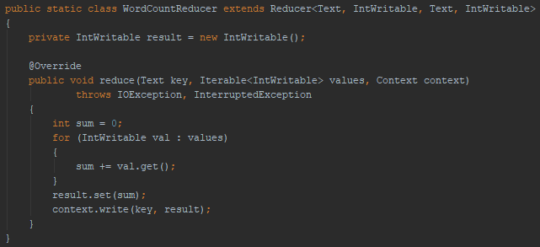
1. JAVA CODE INMAPPERWORDCOUNT
MAPPER
REDUCER

Slide 4
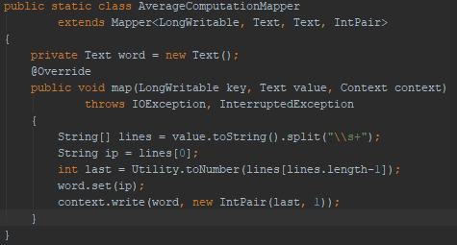
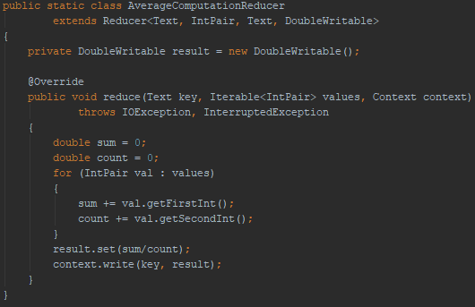
2. JAVA CODE AVERAGE
MAPPER
REDUCER

Slide 5
3. AVERAGE COMPUTATION OUTPUT
[root@quickstart /]# hadoop fs -cat /user/cloudera/averagecomputation/noinmapper/output/part-r-00000

Slide 6
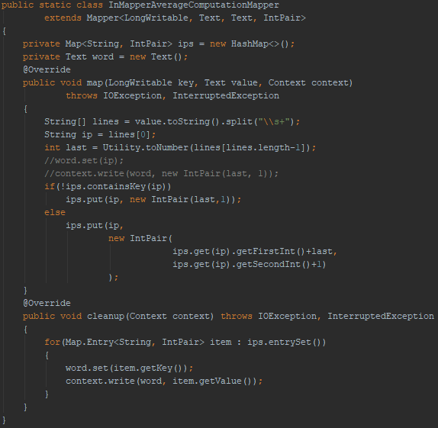
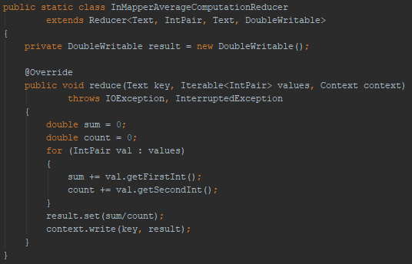
4. JAVA CODE IN MAPPER AVERAGE
MAPPER
REDUCER

Slide 7
5. JAVA CODE IN MAPPER AVERAGE OUTPUT
[root@quickstart /]# hadoop fs -cat /user/cloudera/averagecomputation/inmapper/output/part-r-00000

Slide 8
6. PSEUDO CODE FOR PAIR APPROACH
MAPPER
REDUCER
class Mapper
method map(docid a, doc d)
For all term u in record r do
For all term v in Window(u) do
Emit((u, v), 1)
Emit((u, *), 1)c
class Reducer
method Initialize()
sum = 0
method reduce(Pair(u, v), Integer[c1, c2,…])
s = 0
For all Integer c in [c1, c2, …] do
s = s + c
If(v == ”*”)
sum = s
Else
Emit((u,v), s/sum))

Slide 9
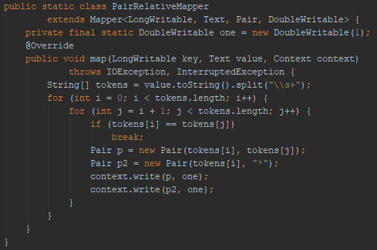
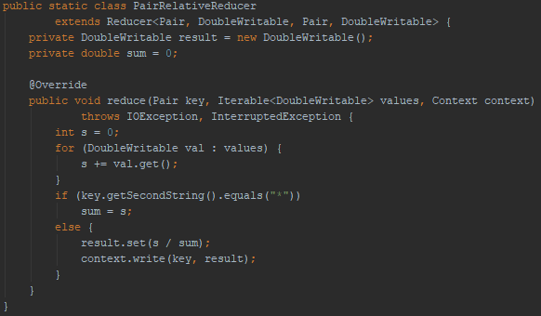
7. JAVA CODE FOR PAIR APPROACH
MAPPER
REDUCER

Slide 10
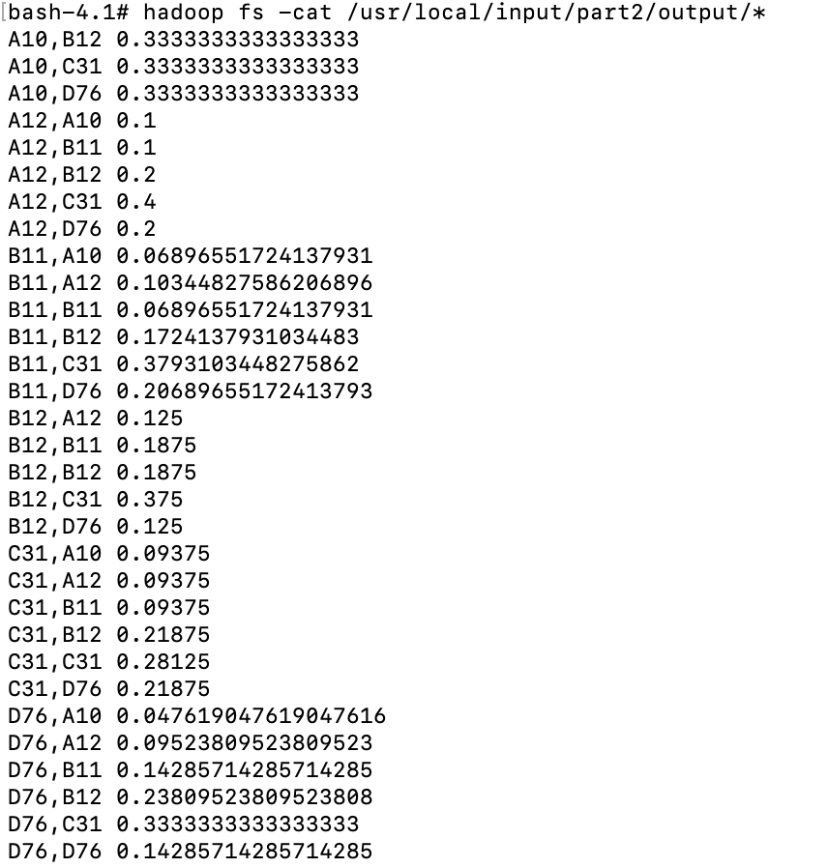
8. RESULT OF PAIR APPROACH

Slide 11
9. PSEUDO CODE FOR STRIPE APPROACH
MAPPER
REDUCER
Class Mapper
Method map(docid a, doc d)
For all term u in record r do
H = new AssociativeArray()
For all term v in Window(u) do
H{v} = H{v} + 1
Emit(u, H)
Class Reducer
Method reduce(term u, AssociativeArray[H1, H2,…])
H_final = new AssociativeArray
For all stripe H in [H1, H2, …] do
H_final = H_final + H
//sum all element in H_final S = sum(H_final)
//divide each element by S
Emit(u, H_final/s)

Slide 12
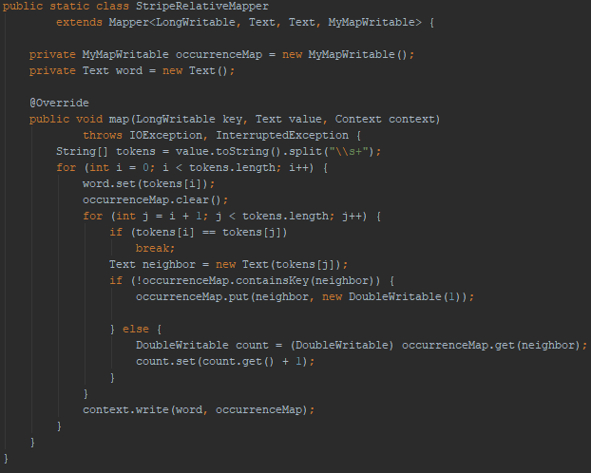
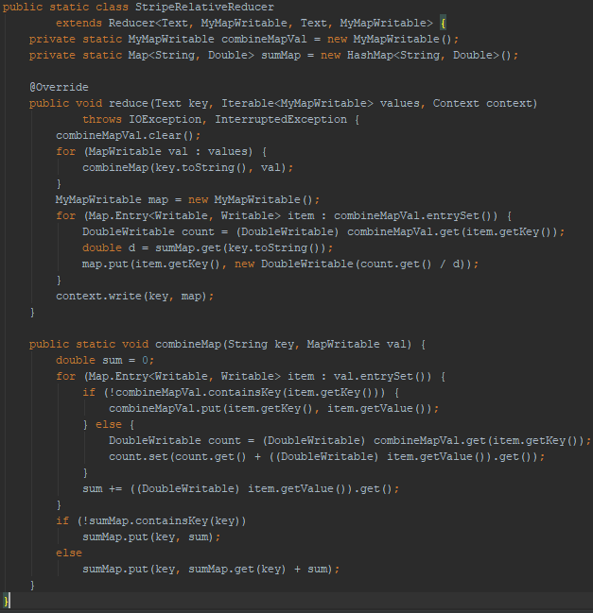
10. JAVA CODE FOR STRIPE APPROACH
MAPPER
REDUCER

Slide 13
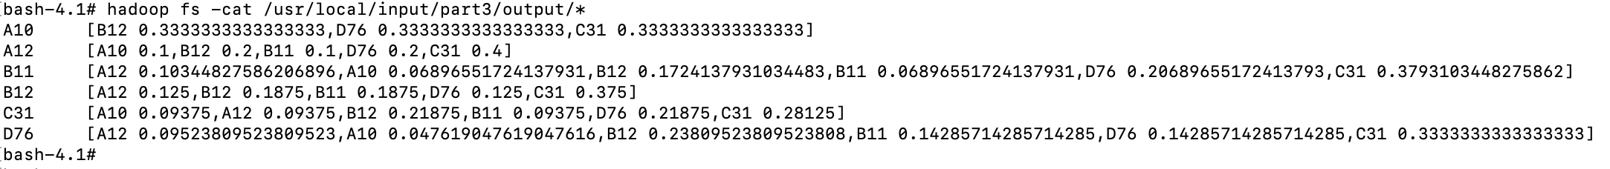
11. RESULT OF STRIPE APPROACH

Slide 14
12. PSEUDO CODE FOR HYBRID APPROACH
MAPPER
REDUCER
class Mapper
method map(docid a, doc d)
For all term u in record r do
For all term v in Window(u) do
Emit((u, v), 1)
Emit((u, *), 1)
Class Reducer
method Initialize()
H_final = new AssociativeArray()
H = new AssociativeArray
H_total = new AssociativeArray
Method reduce(Pair(u, v), Integer[c1, c2,…])
s = 0
For all Integer c in [c1, c2, …] do
s = s + c
If(v==”*”)
H_total{u} = H_total{u} + s
Else
//elementwise addition
H{v} = H{v} + s
//elementwise addition
H_final{u} = H_final{u} + H{v}
Mothod close()
For all term u in H_final
Emit(u, H_final{u}/H_total{u})

Slide 15
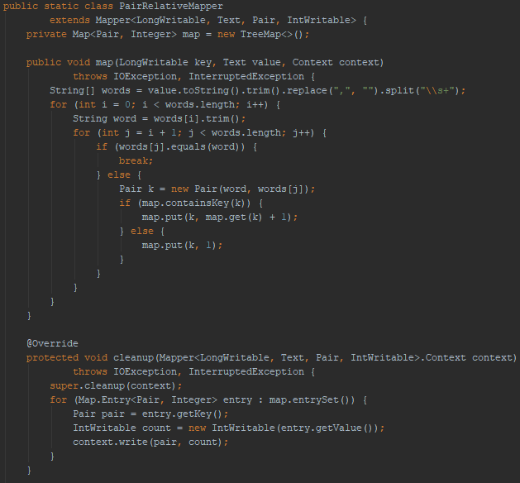
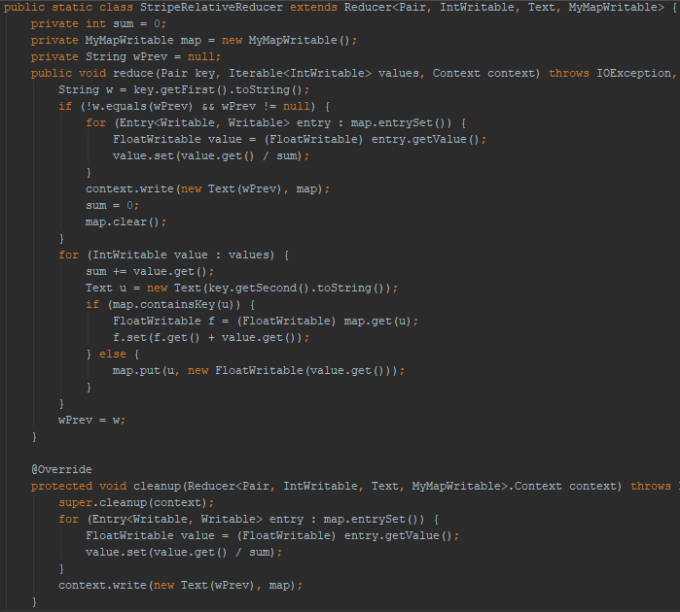
13. JAVA CODE FOR HYBRID APPROACH
MAPPER
REDUCER

Slide 16
13. JAVA CODE FOR HYBRID APPROACH
MAPPER
REDUCER

Slide 17
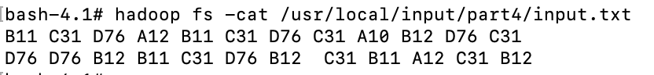
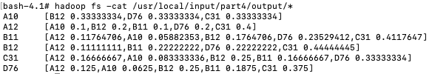
14. RESULT OF HYBRID APPROACH
Input
Output

Slide 18
15. TIME AND RESOURCE COMPARISON : PAIR-STRIPE-HYBRID
 | Pair | Stripe | Hybrid
Total time spent by all maps in occupied slots (ms) | 2013 | 2011 | 2003
Total time spent by all reduces in occupied slots (ms) | 2072 | 2075 | 2099
Total time spent by all map tasks (ms) | 2006 | 2009 | 1990
Total time spent by all reduce tasks (ms) | 2064 | 2071 | 2093
GC time elapsed (ms) | 24 | 24 | 24
CPU time spent (ms) | 930 | 920 | 930
Physical memory (bytes) snapshot | 582598656 | 582561792 | 581439488
Virtual memory (bytes) snapshot | 2767585280 | 2776330240 | 2776150016
Total committed heap usage (bytes) | 1010827264 | 1010827264 | 1010827264

Slide 19
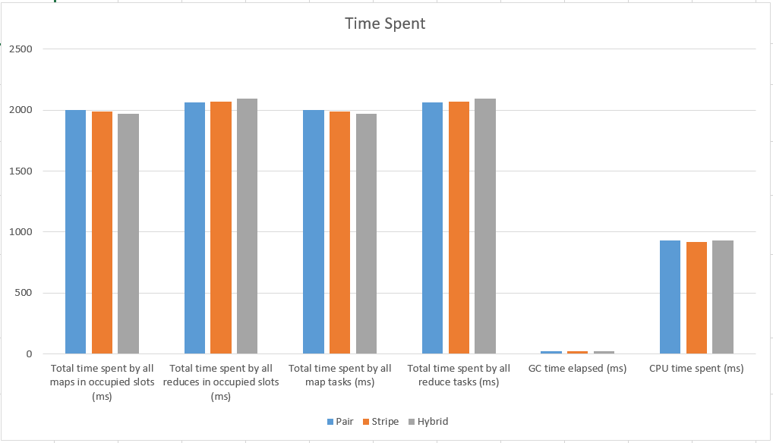
15. TIME AND RESOURCE COMPARISON : PAIR-STRIPE-HYBRID

Slide 20
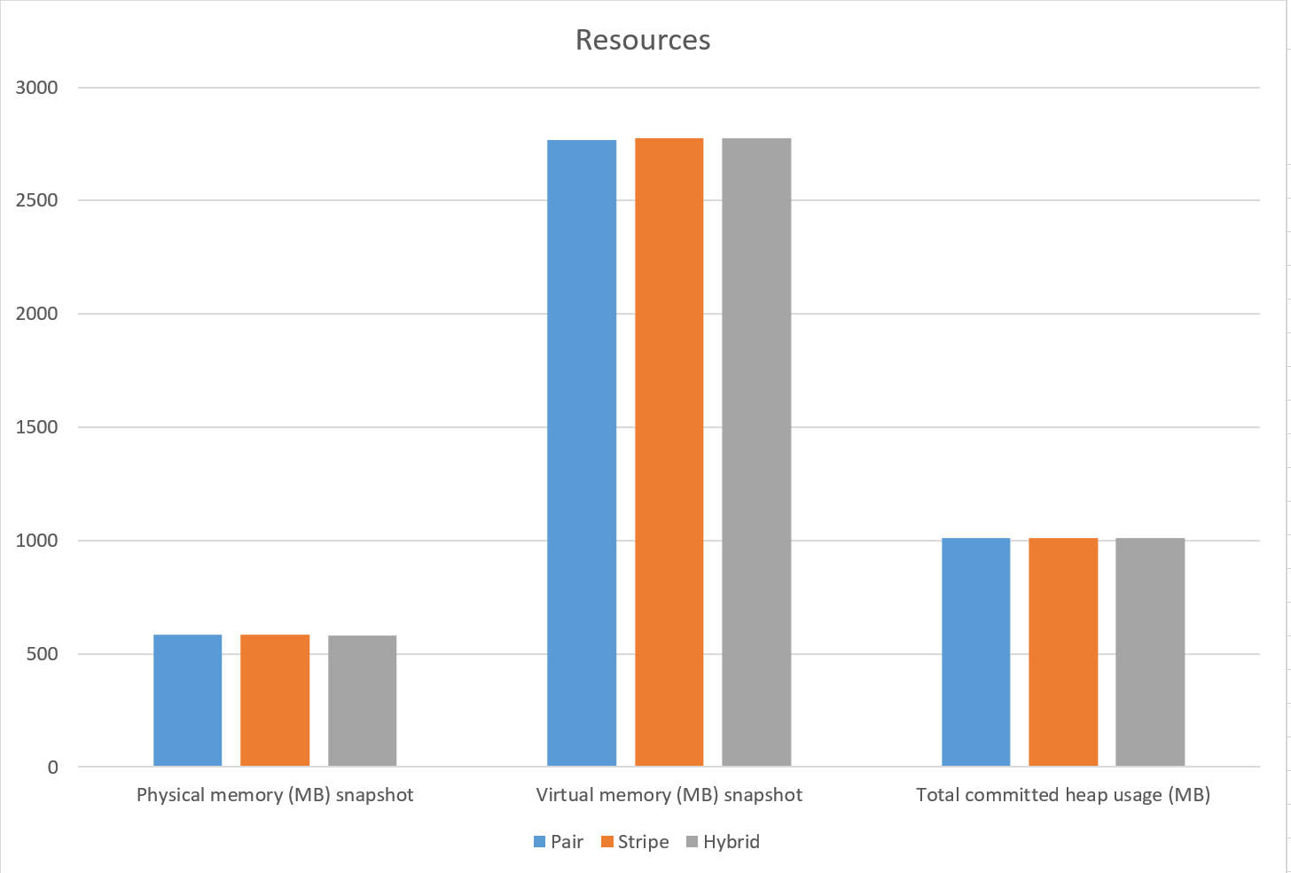
15. TIME AND RESOURCE COMPARISON : PAIR-STRIPE-HYBRID

Slide 21
16. SPARK PROJECT PROBLEM STATEMENT
Apply BootStrapping technique on MTCARS dataset to compute the mean and variance for mpg properties
There are a huge number of resamples need to be done
Replacement = true
Percentage = 5%, 25%, 50% and 100%
Categorial variable: Cycle
Numeric variable: mpg (Miles per gallon)
Dataset: https://vincentarelbundock.github.io/Rdatasets/csv/datasets/mtcars.csv

Slide 22
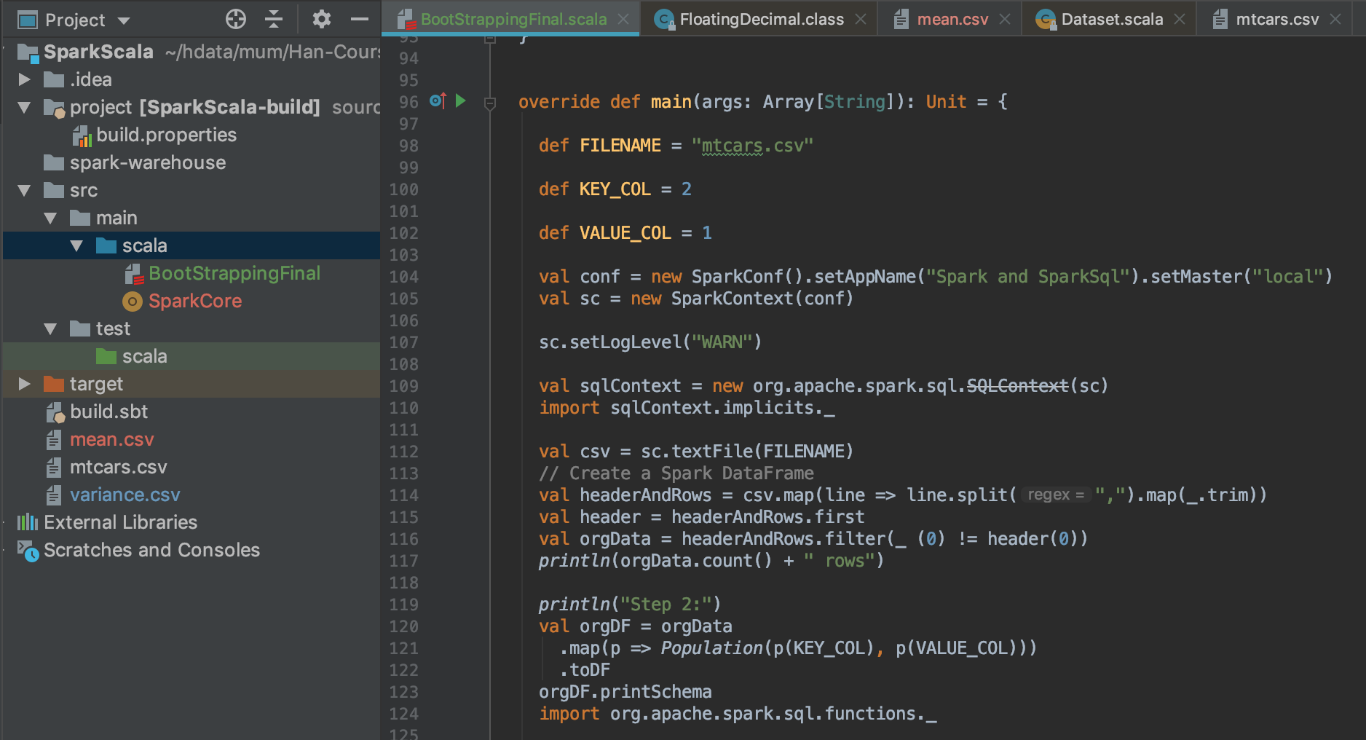
17. SCALA CODE(1)

Slide 23
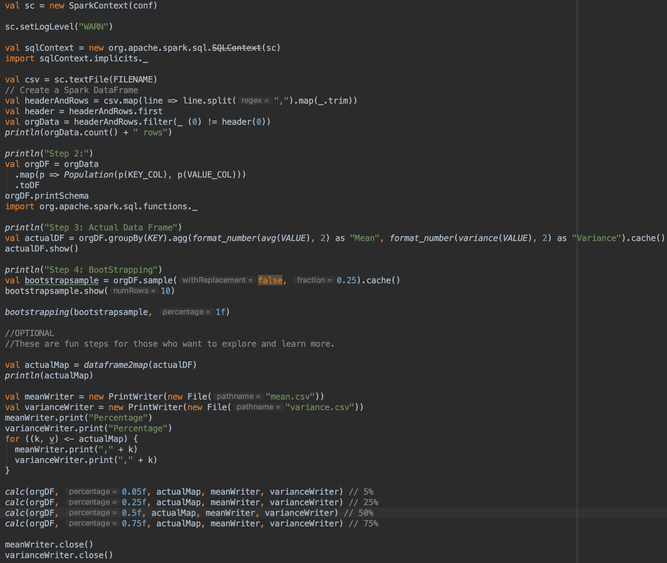
17. SCALA CODE(2)

Slide 24
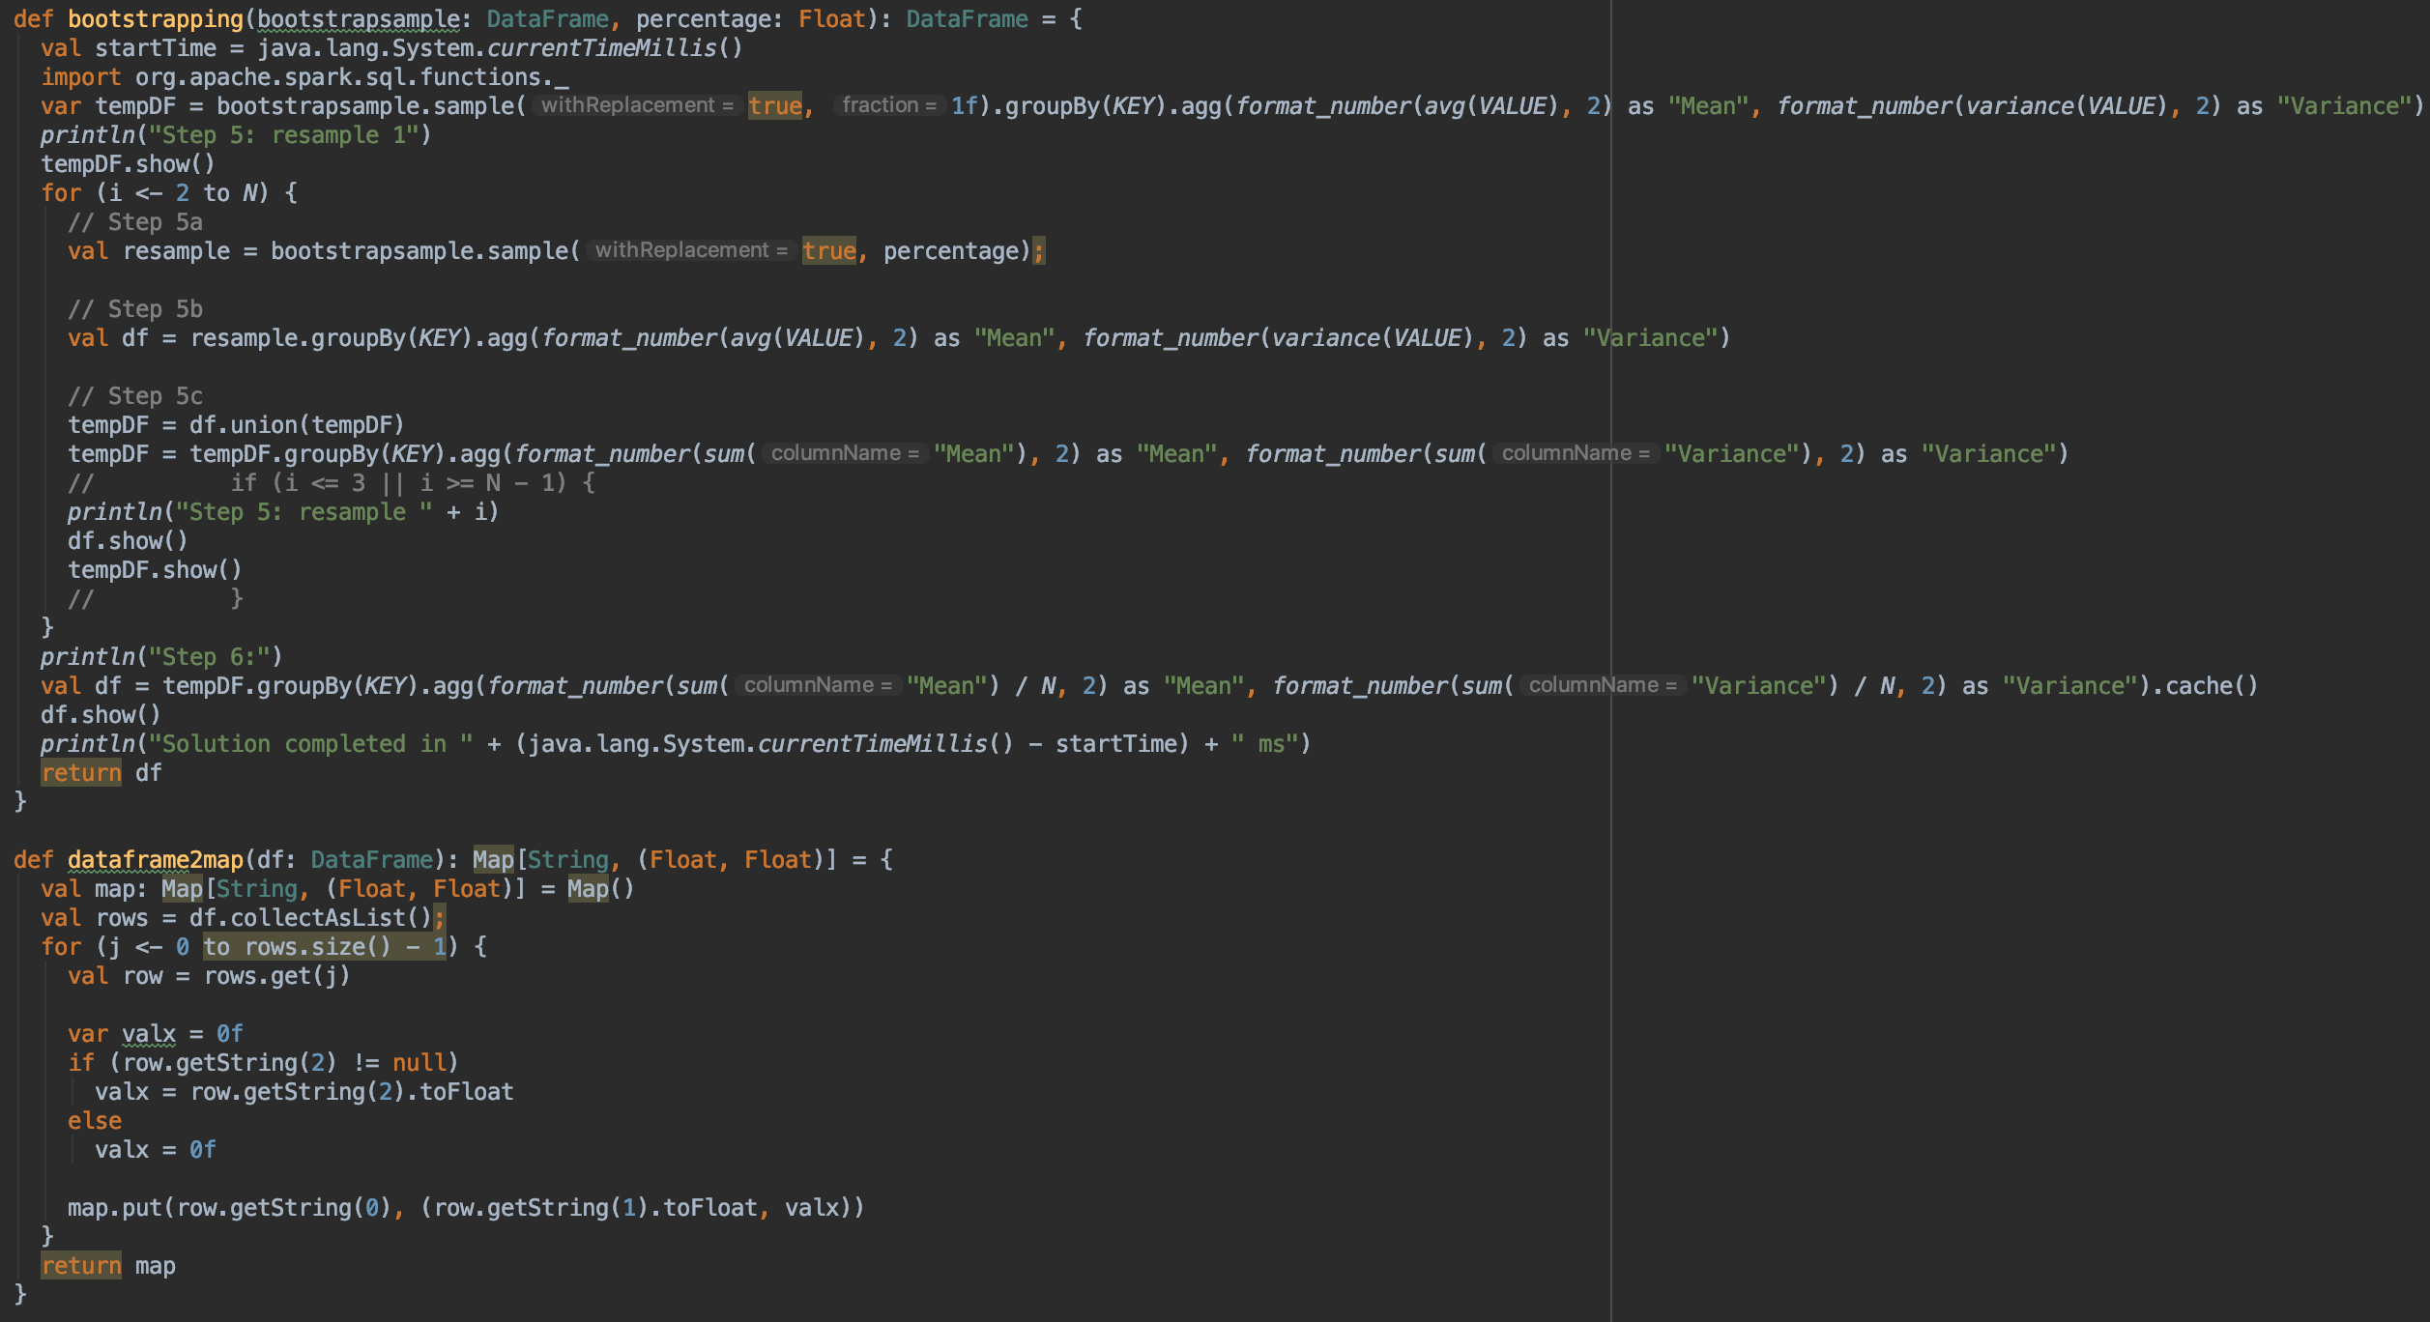
17. SCALA CODE(3)

Slide 25
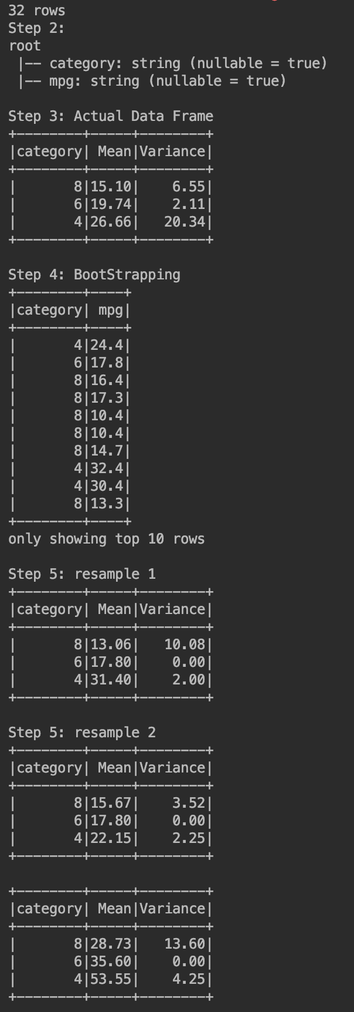
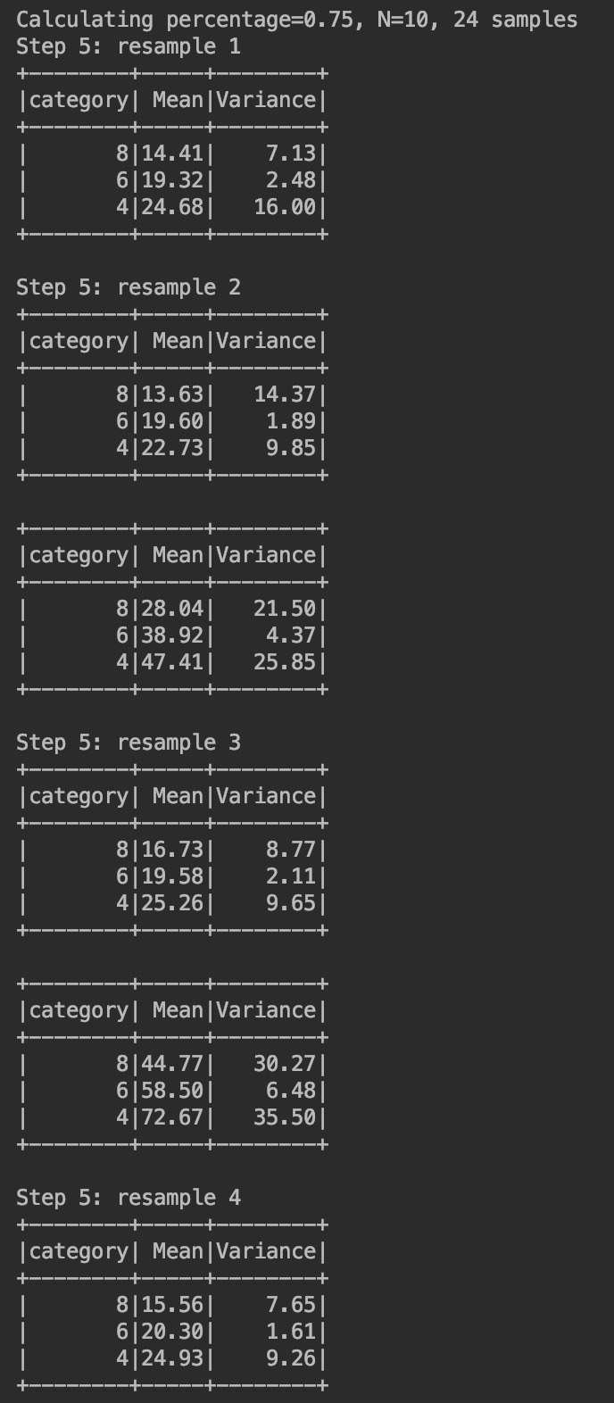
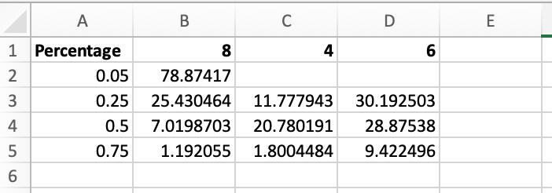
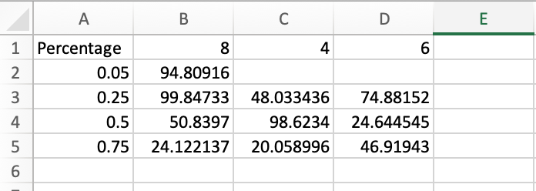
18. SPARK PROJECT OUTPUT

Slide 26
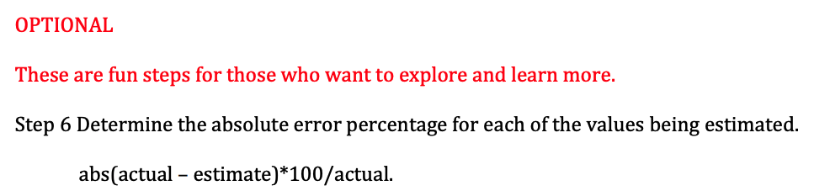
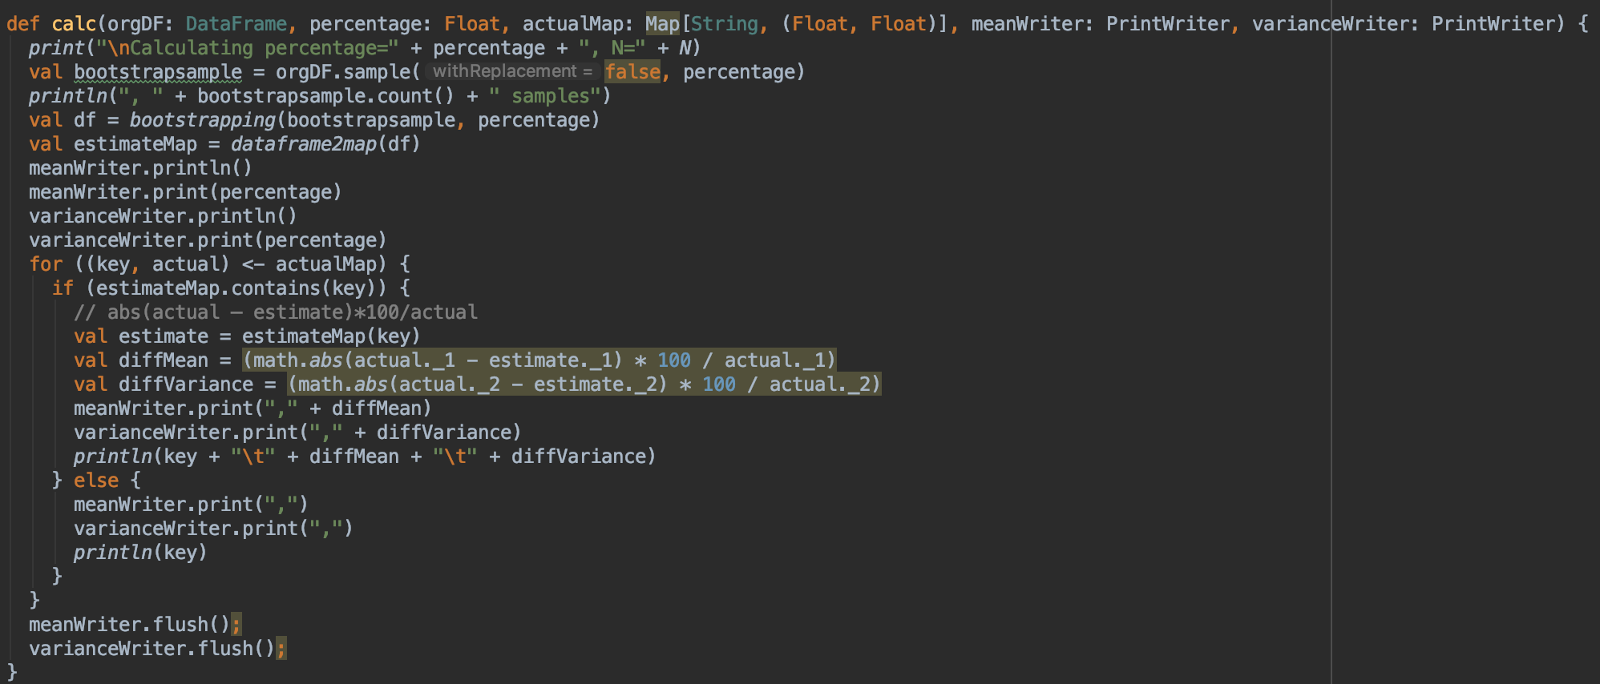
18. OPTIONAL PART

Slide 27
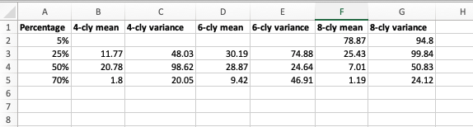
18. OPTIONAL PART

Slide 28


